Slide 1
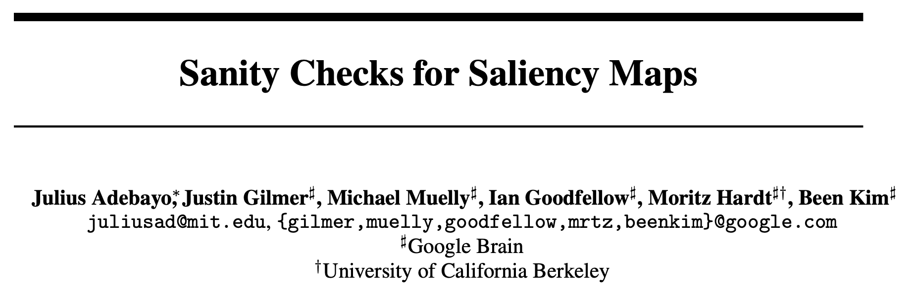
2020.07.08
Reporter：Zhiyi Fu
Notes:
NIPS 2018

Slide 2
OUTLINE
Introduction
Saliency Maps
Model Parameter Randomization Test
Data Randomization Test
Conclusion

Slide 3
OUTLINE
Introduction
Saliency Maps
Model Parameter Randomization Test
Data Randomization Test
Conclusion

Slide 4
Introduction
CNN performs well on many tasks, such as image classification
However, does it really work as expected?
by memorizing samples?
by focusing on insignificant features like background?
…
High accuracy != Understand well
Notes:
1）Over Fitting
2）Pandas v.s. Bamboo

Slide 5
Introduction
Interpretability for DL is more and more important
Saliency methods: a category of visualization and attribution methods aimed as interpreting trained models
White box methods: GBP, GAP-CAM, Grad-CAM,
Black bos methods: LIME, …
Saliency maps: relevant value maps on pixel level, also called saliency mask, explanation map, explanation mask…

Slide 6
Grad-CAM sample
Saliency map/mask

Slide 7
Grad-CAM + GBP sample
Saliency map/mask * GBP map

Slide 8
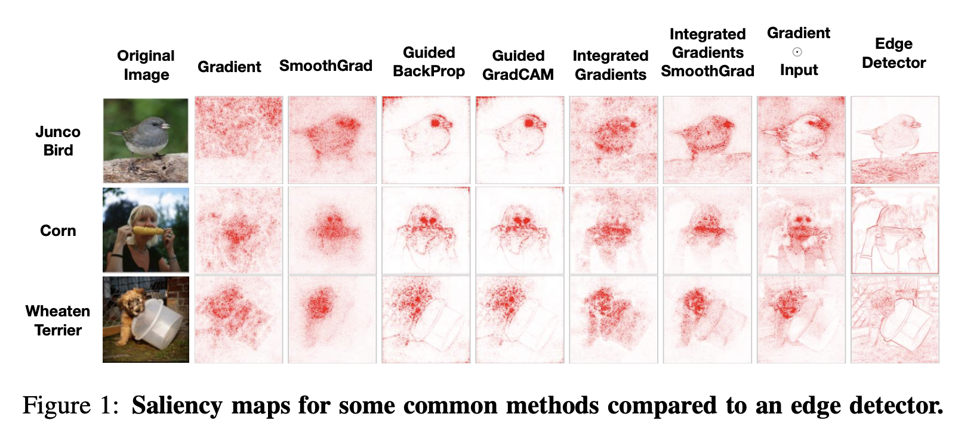
Problem
There are too many saliency methods, which one is better?

Slide 9

Problem
Visual inspection is not a good guidance!
The edge detector does not depend on model or training data, yet produces results similar with saliency maps
Notes:
No target orientation — focus on both dog & cat, bird & branch, foreground & background

Slide 10
Motivation
Saliency methods independent of training data & model are not ideal
In other words, we need to assess the scope and quality of model explanations (saliency maps) to check
Model architecture dependency
Model parameter dependency
Training data dependency
…
Notes:
If totally independent, what is the classification basis?

Slide 11
Methodology
A statistical randomization test, comparing the normal experiment with an artificially randomized experiment
The model parameter randomization test — comparing saliency map on a trained model & saliency map on the model but partially randomized
The data randomization test — comparing saliency map on a trained model & saliency map on the model trained on a label-permuted training set
Notes:
Compare between a single certain (saliency method, model, data) pair.

Slide 12
Methodology
Sanity check: If we discover an invariance incompatible with the requirements of the task at hand, we can safely reject the method
Model parameter insensitive — not helpful for tasks such as model debugging that inevitably depend on the model parameters
Training data insensitive — not helpful for un-supervised image segmentation
Notes:
Compare between a single certain (saliency method, model, data) pair.

Slide 13
Contributions
Propose model parameter randomization test & data randomization test for assessing saliency methods
Find some saliency methods independent of both model parameters & training data labeling
Gradients & Grad-CAM pass the sanity checks, while GBP & Guided Grad-CAM fail
The saliency methods that fail sanity checks are incapable of supporting tasks that require explanations that are faithful to the model or the data generating process
Interpret our findings through a series of analyses of linear models and a simple 1-layer convolutional sum-pooling architecture

Slide 14
OUTLINE
Introduction
Saliency Maps
Model Parameter Randomization Test
Data Randomization Test
Conclusion

Slide 15
Saliency Maps
Input $x∈R^{d}$
Model $S:R^{d}→R^{C}$, C is the number of classes
Saliency/Explanation Map $E:R^{d}→R^{d}$, maps inputs to objects with same shape
This paper mainly compared gradient-based approaches
Notes:
There are other learning saliency methods like DeepLift, SHAP

Slide 16
Gradient-based Saliency Methods
Gradient：$E_{grad}(x)=\frac{∂S}{∂x}$
Gradient $⊙$ Input：$x⊙\frac{∂S}{∂x}$
Integrated Gradients (IG)：$E_{IG}(x)=(x-\overline{x})×∫_{0}^{1}\frac{∂S(\overline{x}+α(x-\overline{x}))}{∂x}dα$
Guided Back Propagation (GBP)
Guided GradCAM (GPB + GradCAM)：pixel-level GradCAM $⊙$ GBP
SmoothGrad (SG)：$E_{sg}(x)=\frac{1}{N}\overset{N}{\underset{i=1}{∑}}E(x+g_{i}),g_{i}∼N(0,σ^{2})$
…

Slide 17
Gradient-based Saliency Methods
Guided Back Propagation (GBP) v.s. BP v.s. Deconv

Slide 18
Gradient-based Saliency Methods
Guided Back Propagation (GBP) v.s. BP v.s. Deconv
Label insensitive
Training Data invariant
Lack of neuron discriminativity

Slide 19
Gradient-based Saliency Methods
GradCAM：$L_{GradCAM}^{c}=ReLU(\underset{k}{∑}α_{k}^{c}A^{k})$，$α_{k}^{c}=\frac{1}{Z}\underset{i}{∑}\underset{j}{∑}\frac{∂y^{c}}{∂A_{ij}^{k}}$
Label sensitive

Slide 20
OUTLINE
Introduction
Saliency Maps
Model Parameter Randomization Test
Data Randomization Test
Conclusion

Slide 21
Model Parameter Randomization Test
Assess an explanation method’s sensitivity to model parameters
Cascading randomization (top-down layers)
Independent randomization (single layer)
Similarity Metrics:
Spearman rank correlation with/without absolute value
SSIM — structural similarity index
HOGs — Pearson correlation of the histogram go gradients

Slide 22
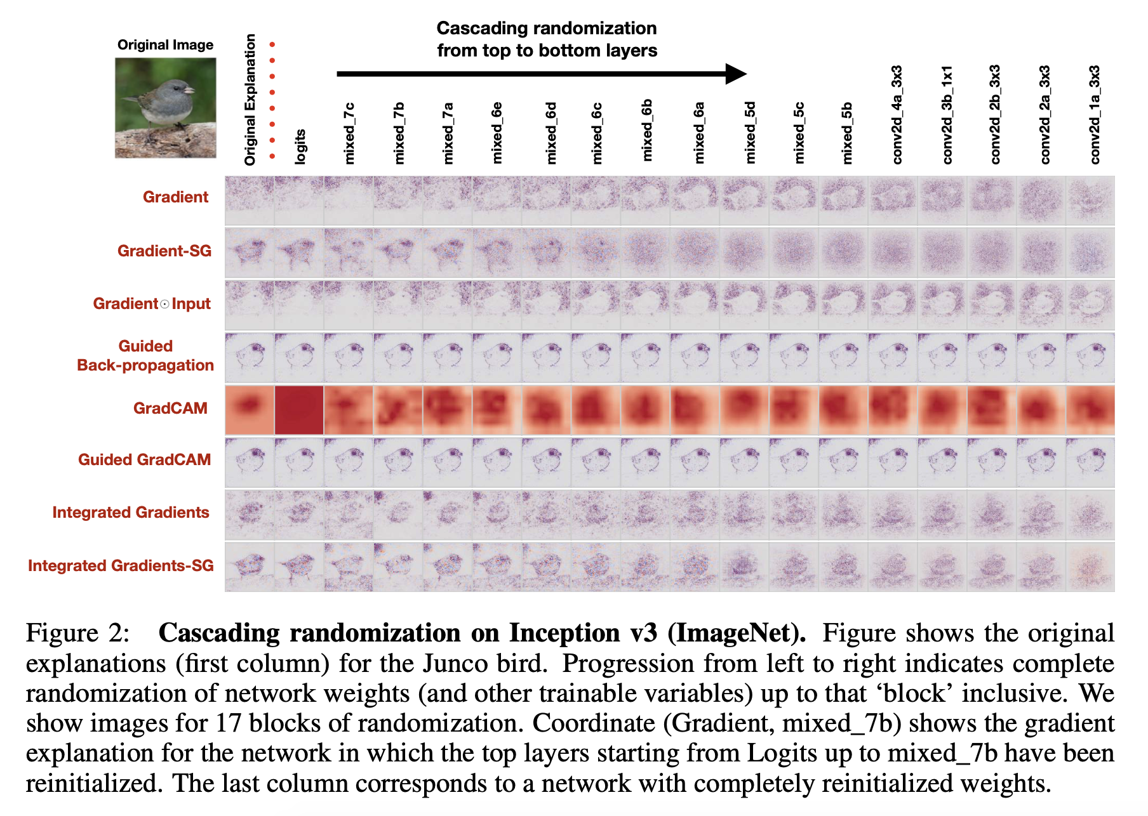
Cascading Parameter Randomization Test
Notes:
The danger of the visual assessment: Gradient & Gradient \odot Input

Slide 23
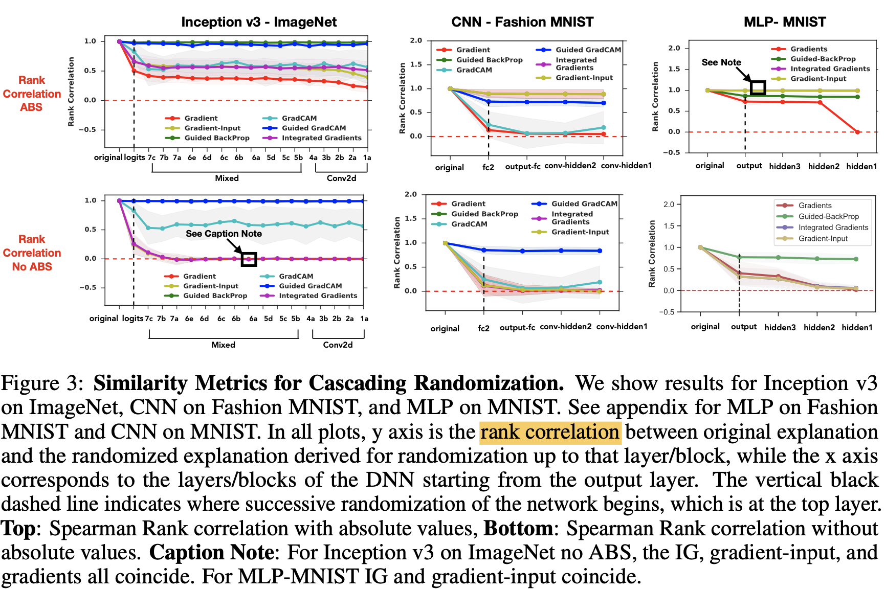
Cascading Parameter Randomization Test

Slide 24
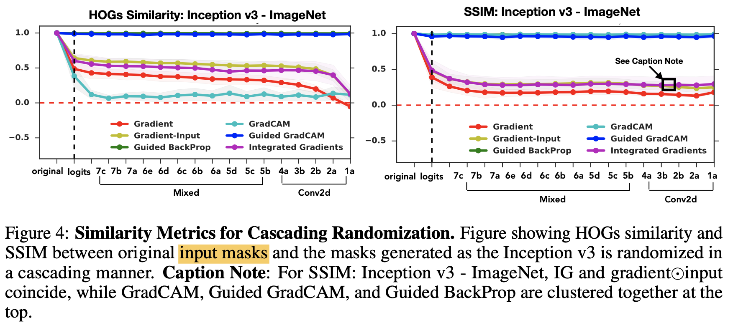
Cascading Parameter Randomization Test

Slide 25
Cascading Parameter Randomization Test
Gradient map is sensitive to model parameters
GradCAM mask is sensitive to model parameters
GBP and Guided GradCAM are insensitive to model parameters
The danger of the visual assessment: Gradient & Gradient $⊙$ Input
Notes:
Independent Randomization has similar results

Slide 26
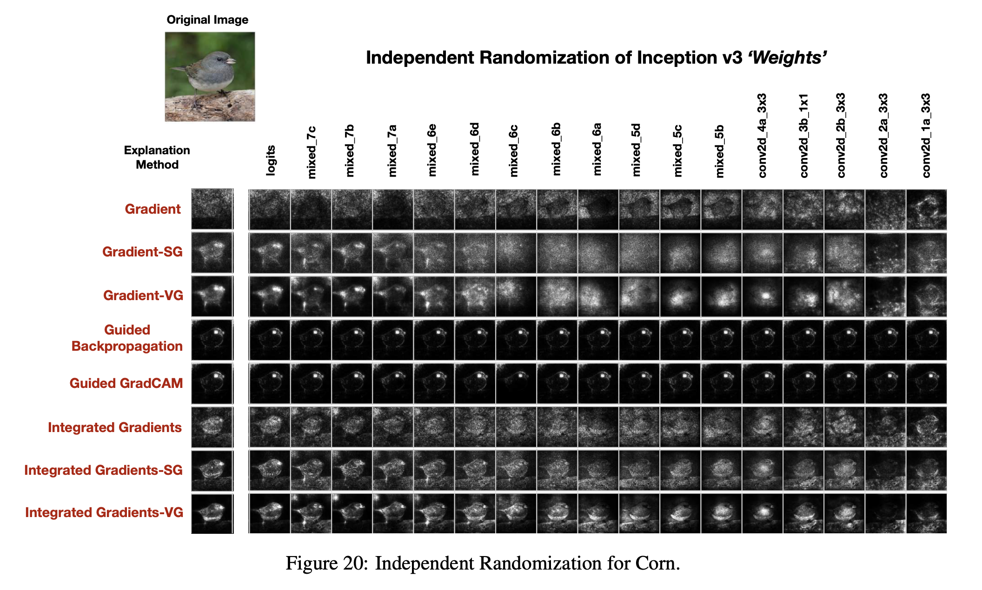
Independent Parameter Randomization Test

Slide 27
OUTLINE
Introduction
Saliency Maps
Model Parameter Randomization Test
Data Randomization Test
Conclusion

Slide 28
Data Randomization Test
Randomize the labels, no predictive model can do better than random guessing
Model trained on randomized training data is forced to memorize data, not able to exploit the original structure in the data
Evaluate the sensitivity of an explanation method to the relationship between instances and labels
Sample: CT scan & diagnosis

Slide 29
Data Randomization Test
Train model to greater than 95% training set accuracy
Then compute explanations on same test bed of inputs for normal-trained model & random-trained model

Slide 30
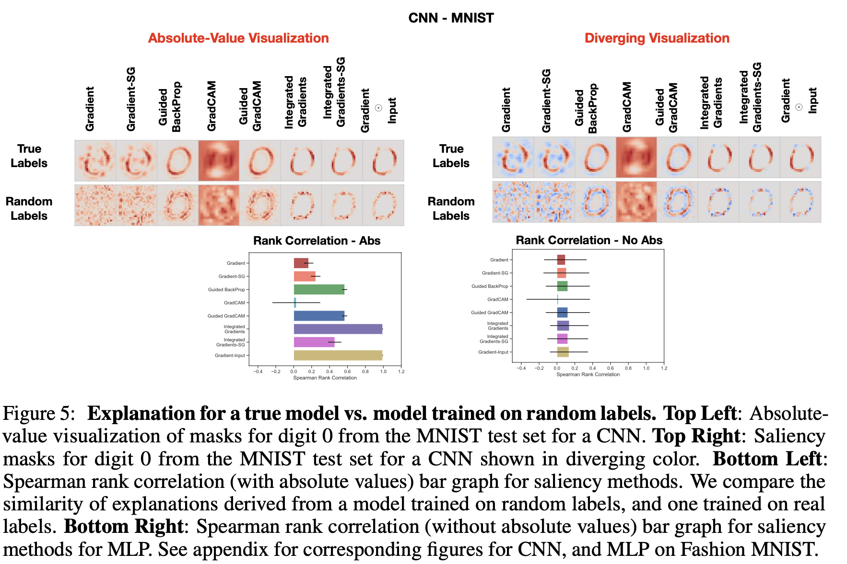
Data Randomization Test

Slide 31
Data Randomization Test
Gradient map is sensitive to model parameters
GradCAM mask is dramatically sensitive to model parameters
GBP and Guided GradCAM are insensitive to model parameters
IG and Gradient $⊙$ Input are strongly insensitive
The danger of the visual assessment (like GBP)

Slide 32
OUTLINE
Introduction
Saliency Maps
Model Parameter Randomization Test
Data Randomization Test
Conclusion

Slide 33
Conclusion — Discussion
Model architecture is a prior, randomly initialized correspond to non-tribal representations
Saliency methods approximating element-wise input-gradient products mostly return the input
Many saliency methods act like edge detectors, suggesting that CNN is responsible for edge detecting relative tasks
To differentiate model/data -sensitive saliency methods, visual inspection is insufficient

Slide 34
Conclusion
Saliency methods have different scope and quality
Invariances in saliency methods give a concrete way to rule out the adequacy of the method for certain tasks, like model parameter randomization test in this paper
Visual inspection alone is not reliable, lacking sensitivity to the model and data generating process
GradCAM is suitable for unsupervised localization task cause it is data-sensitive

Slide 35
THANKS！

